Slide 1
SU-19-03_SP-78-04 San Juan, Siquijor

Slide 2
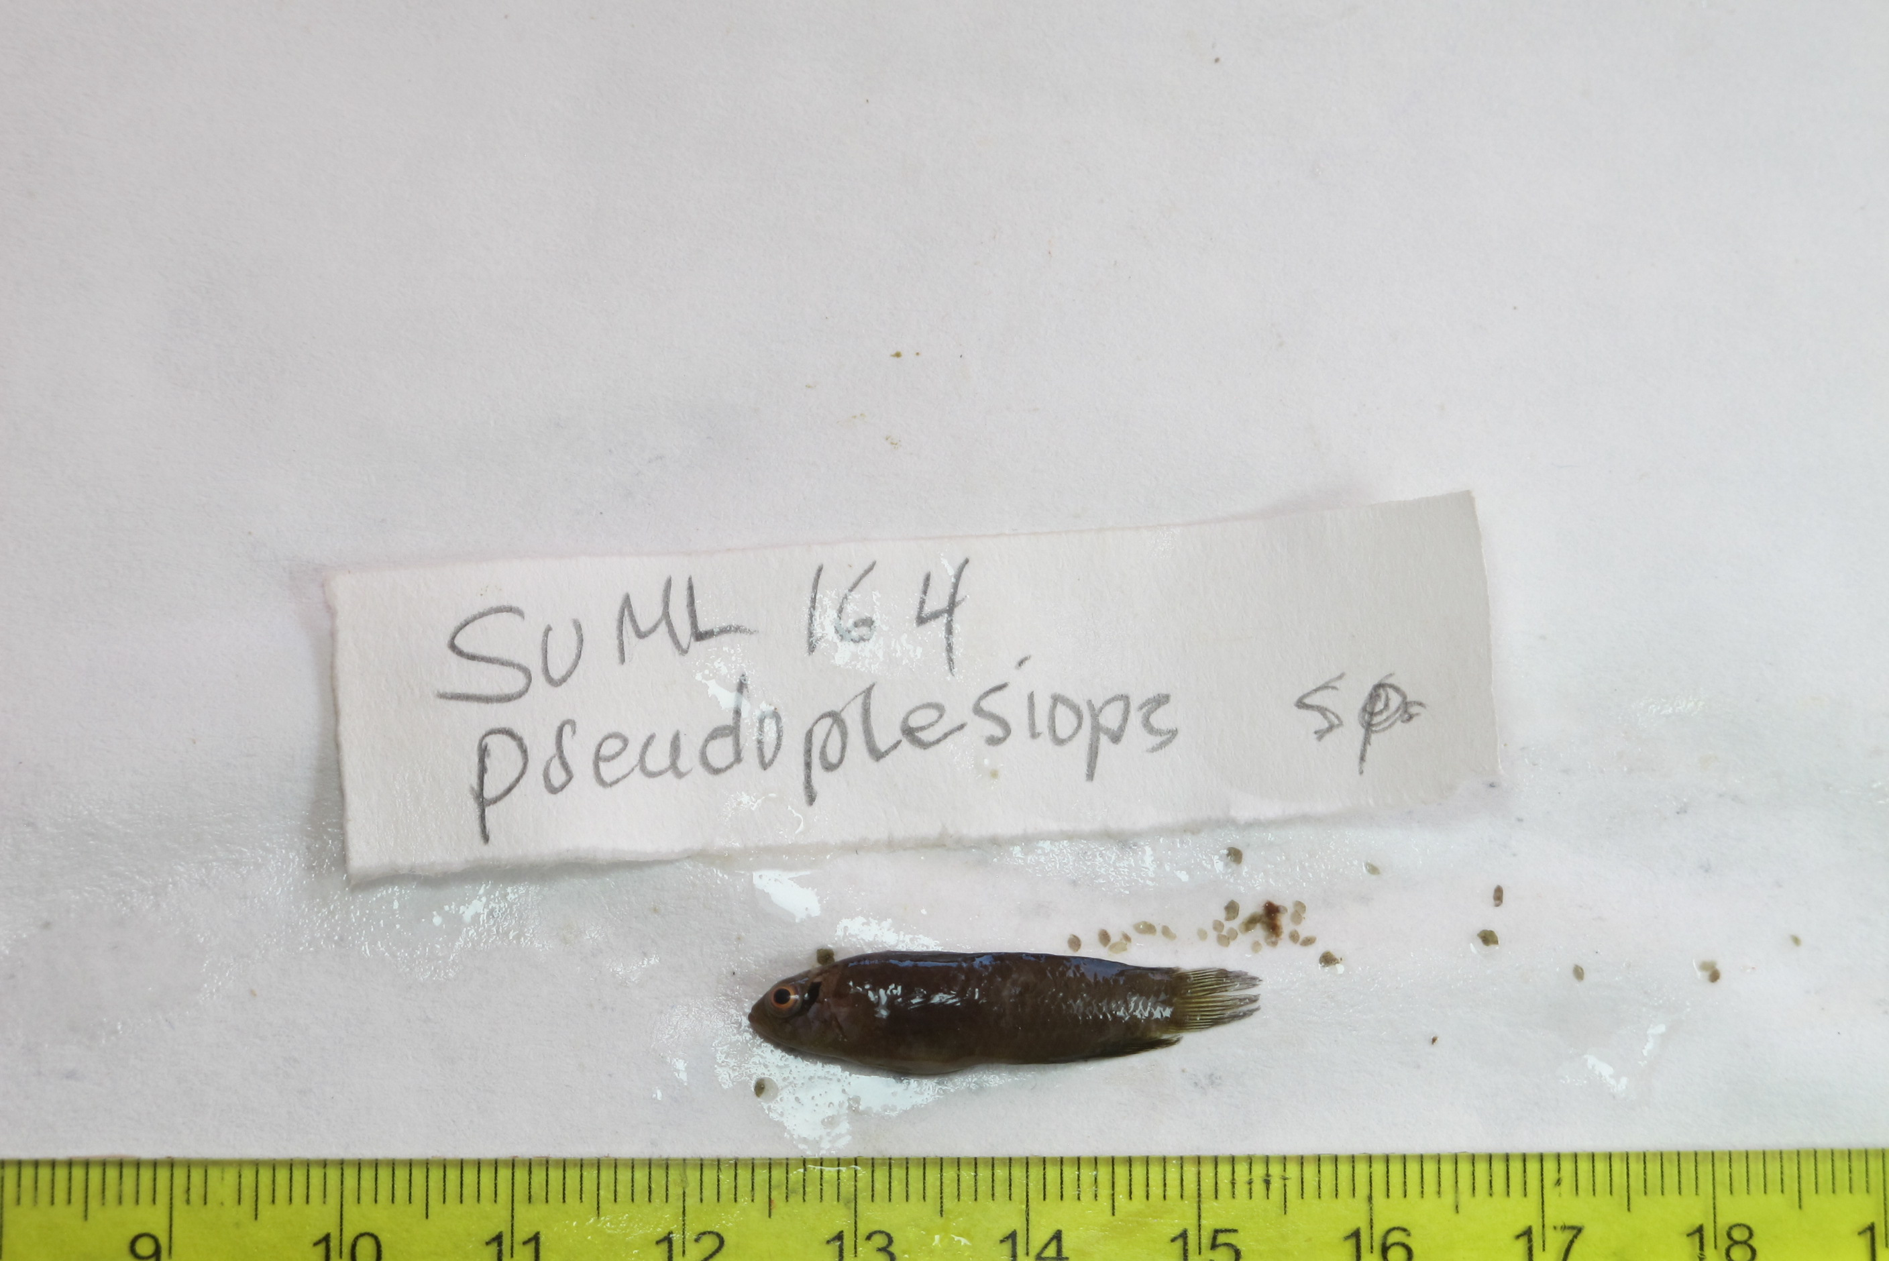
SU-19-03_043 (SUML-164) Original ID: Pseudoplesiops sp. Jeff’s ID:

Slide 3
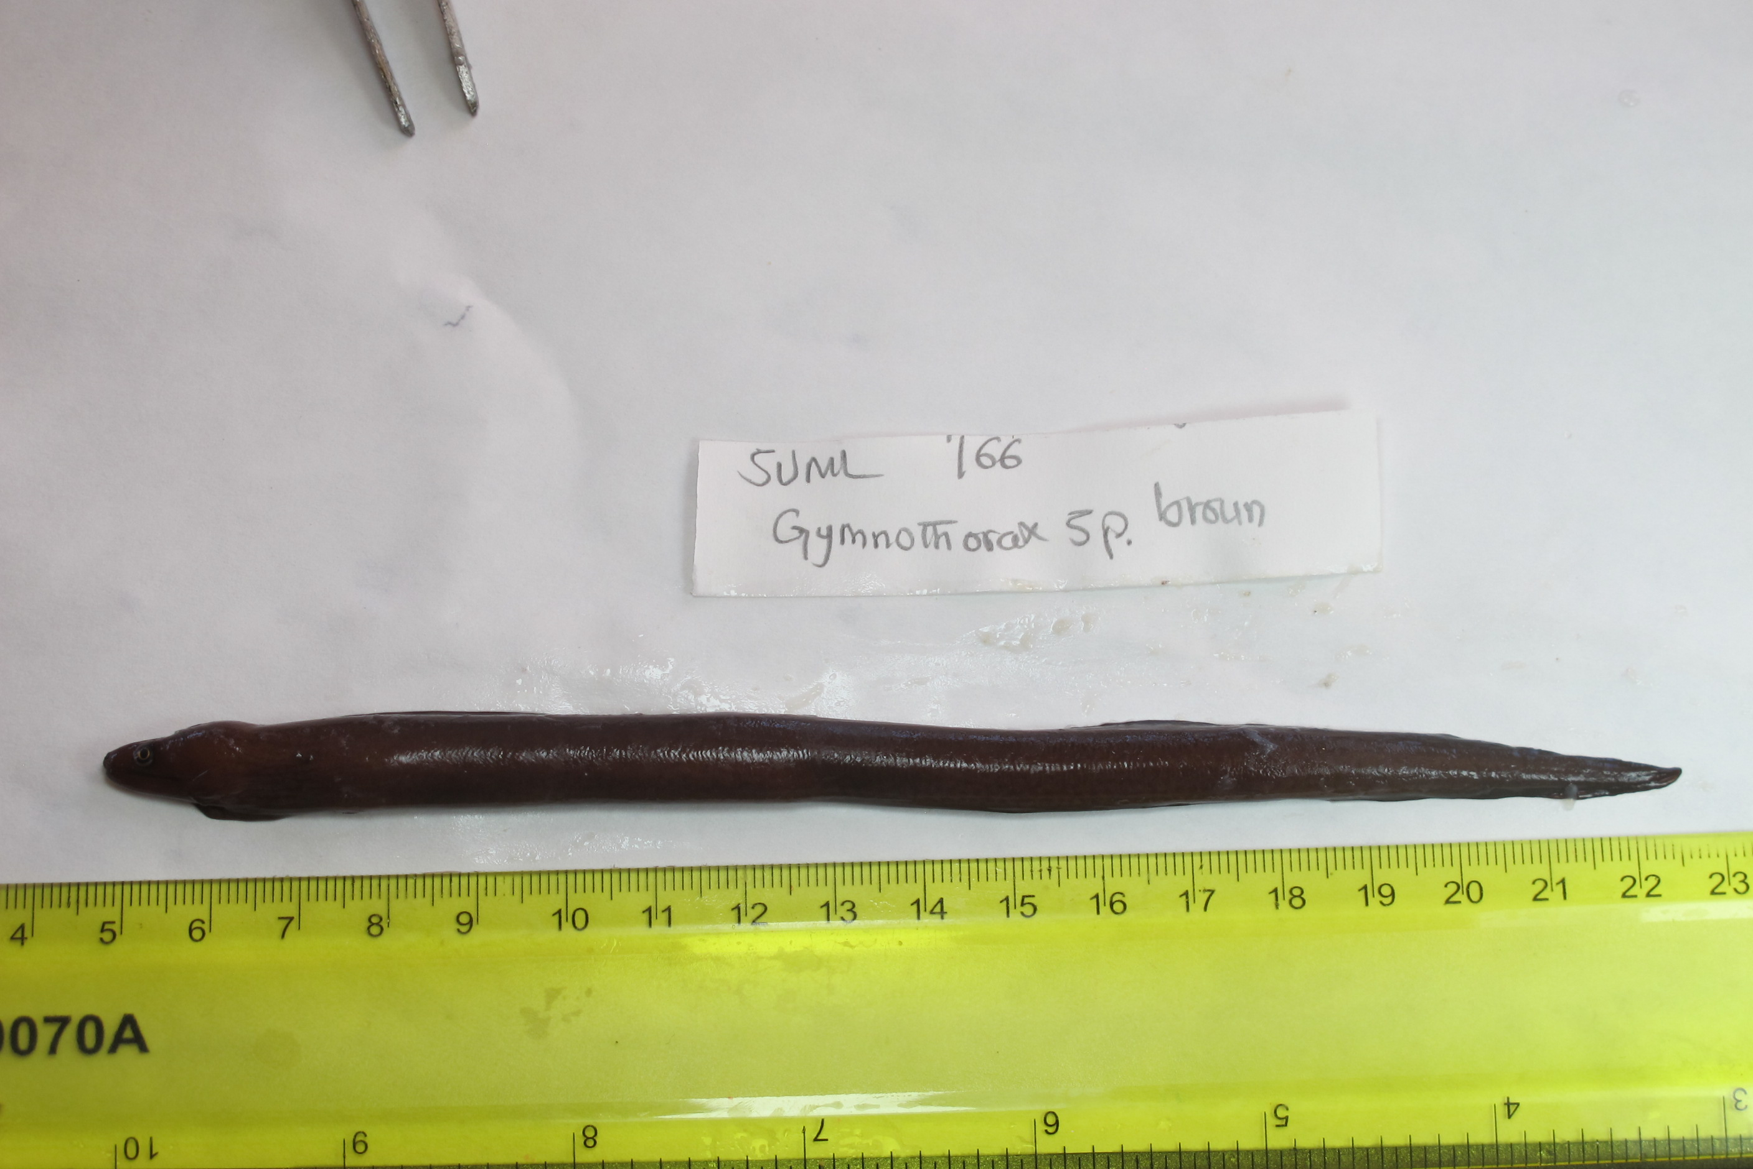
SU-19-03_045 (SUML-166) Original ID: Gymnothorax sp. (brown) Jeff’s ID:

Slide 4
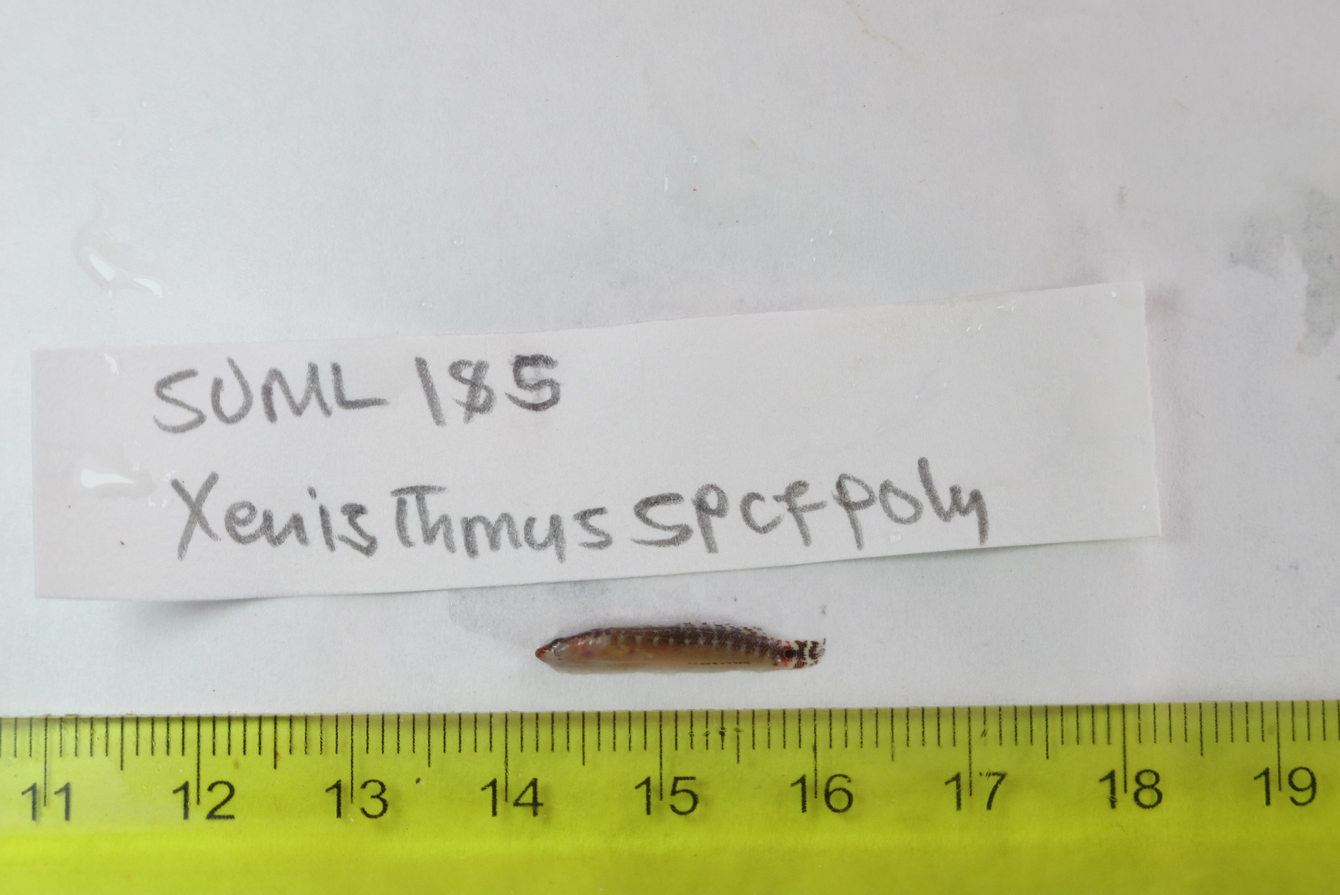
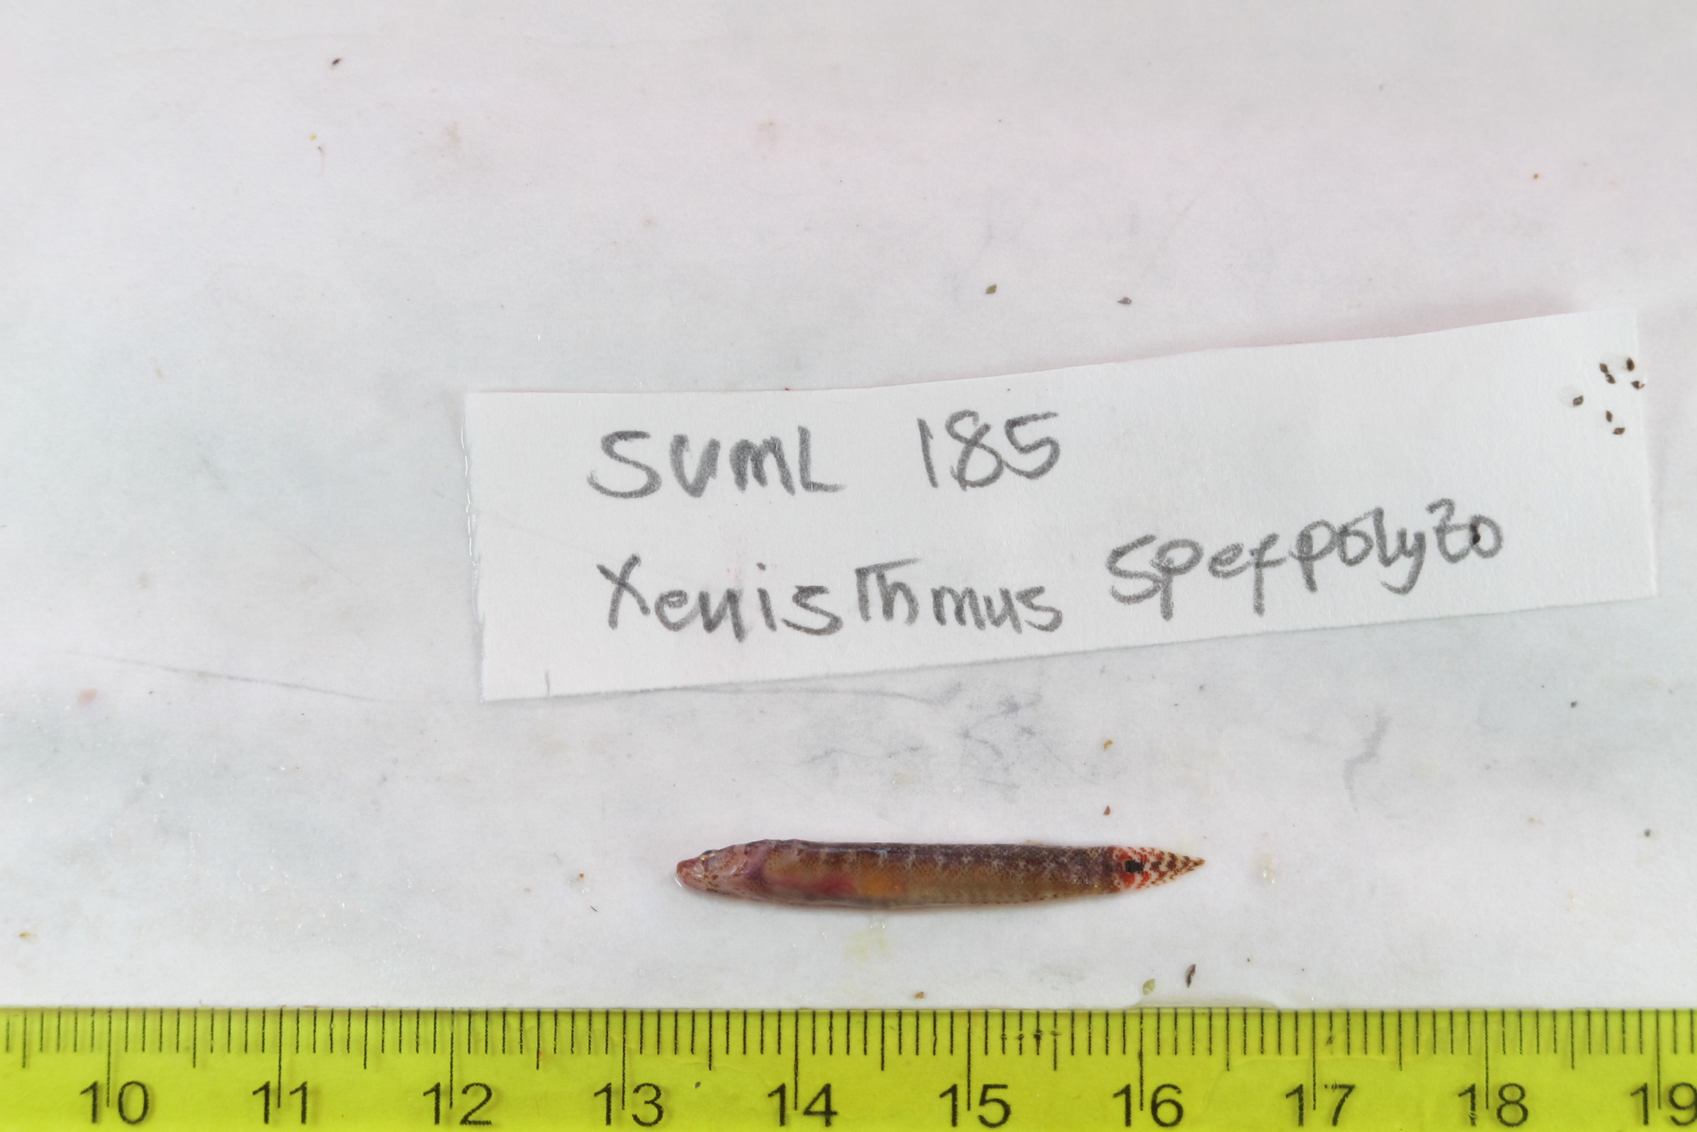
SU-19-03_064 (SUML-185) Original ID: Xenisthmus sp. cf. polyzonatus Jeff’s ID:

Slide 5
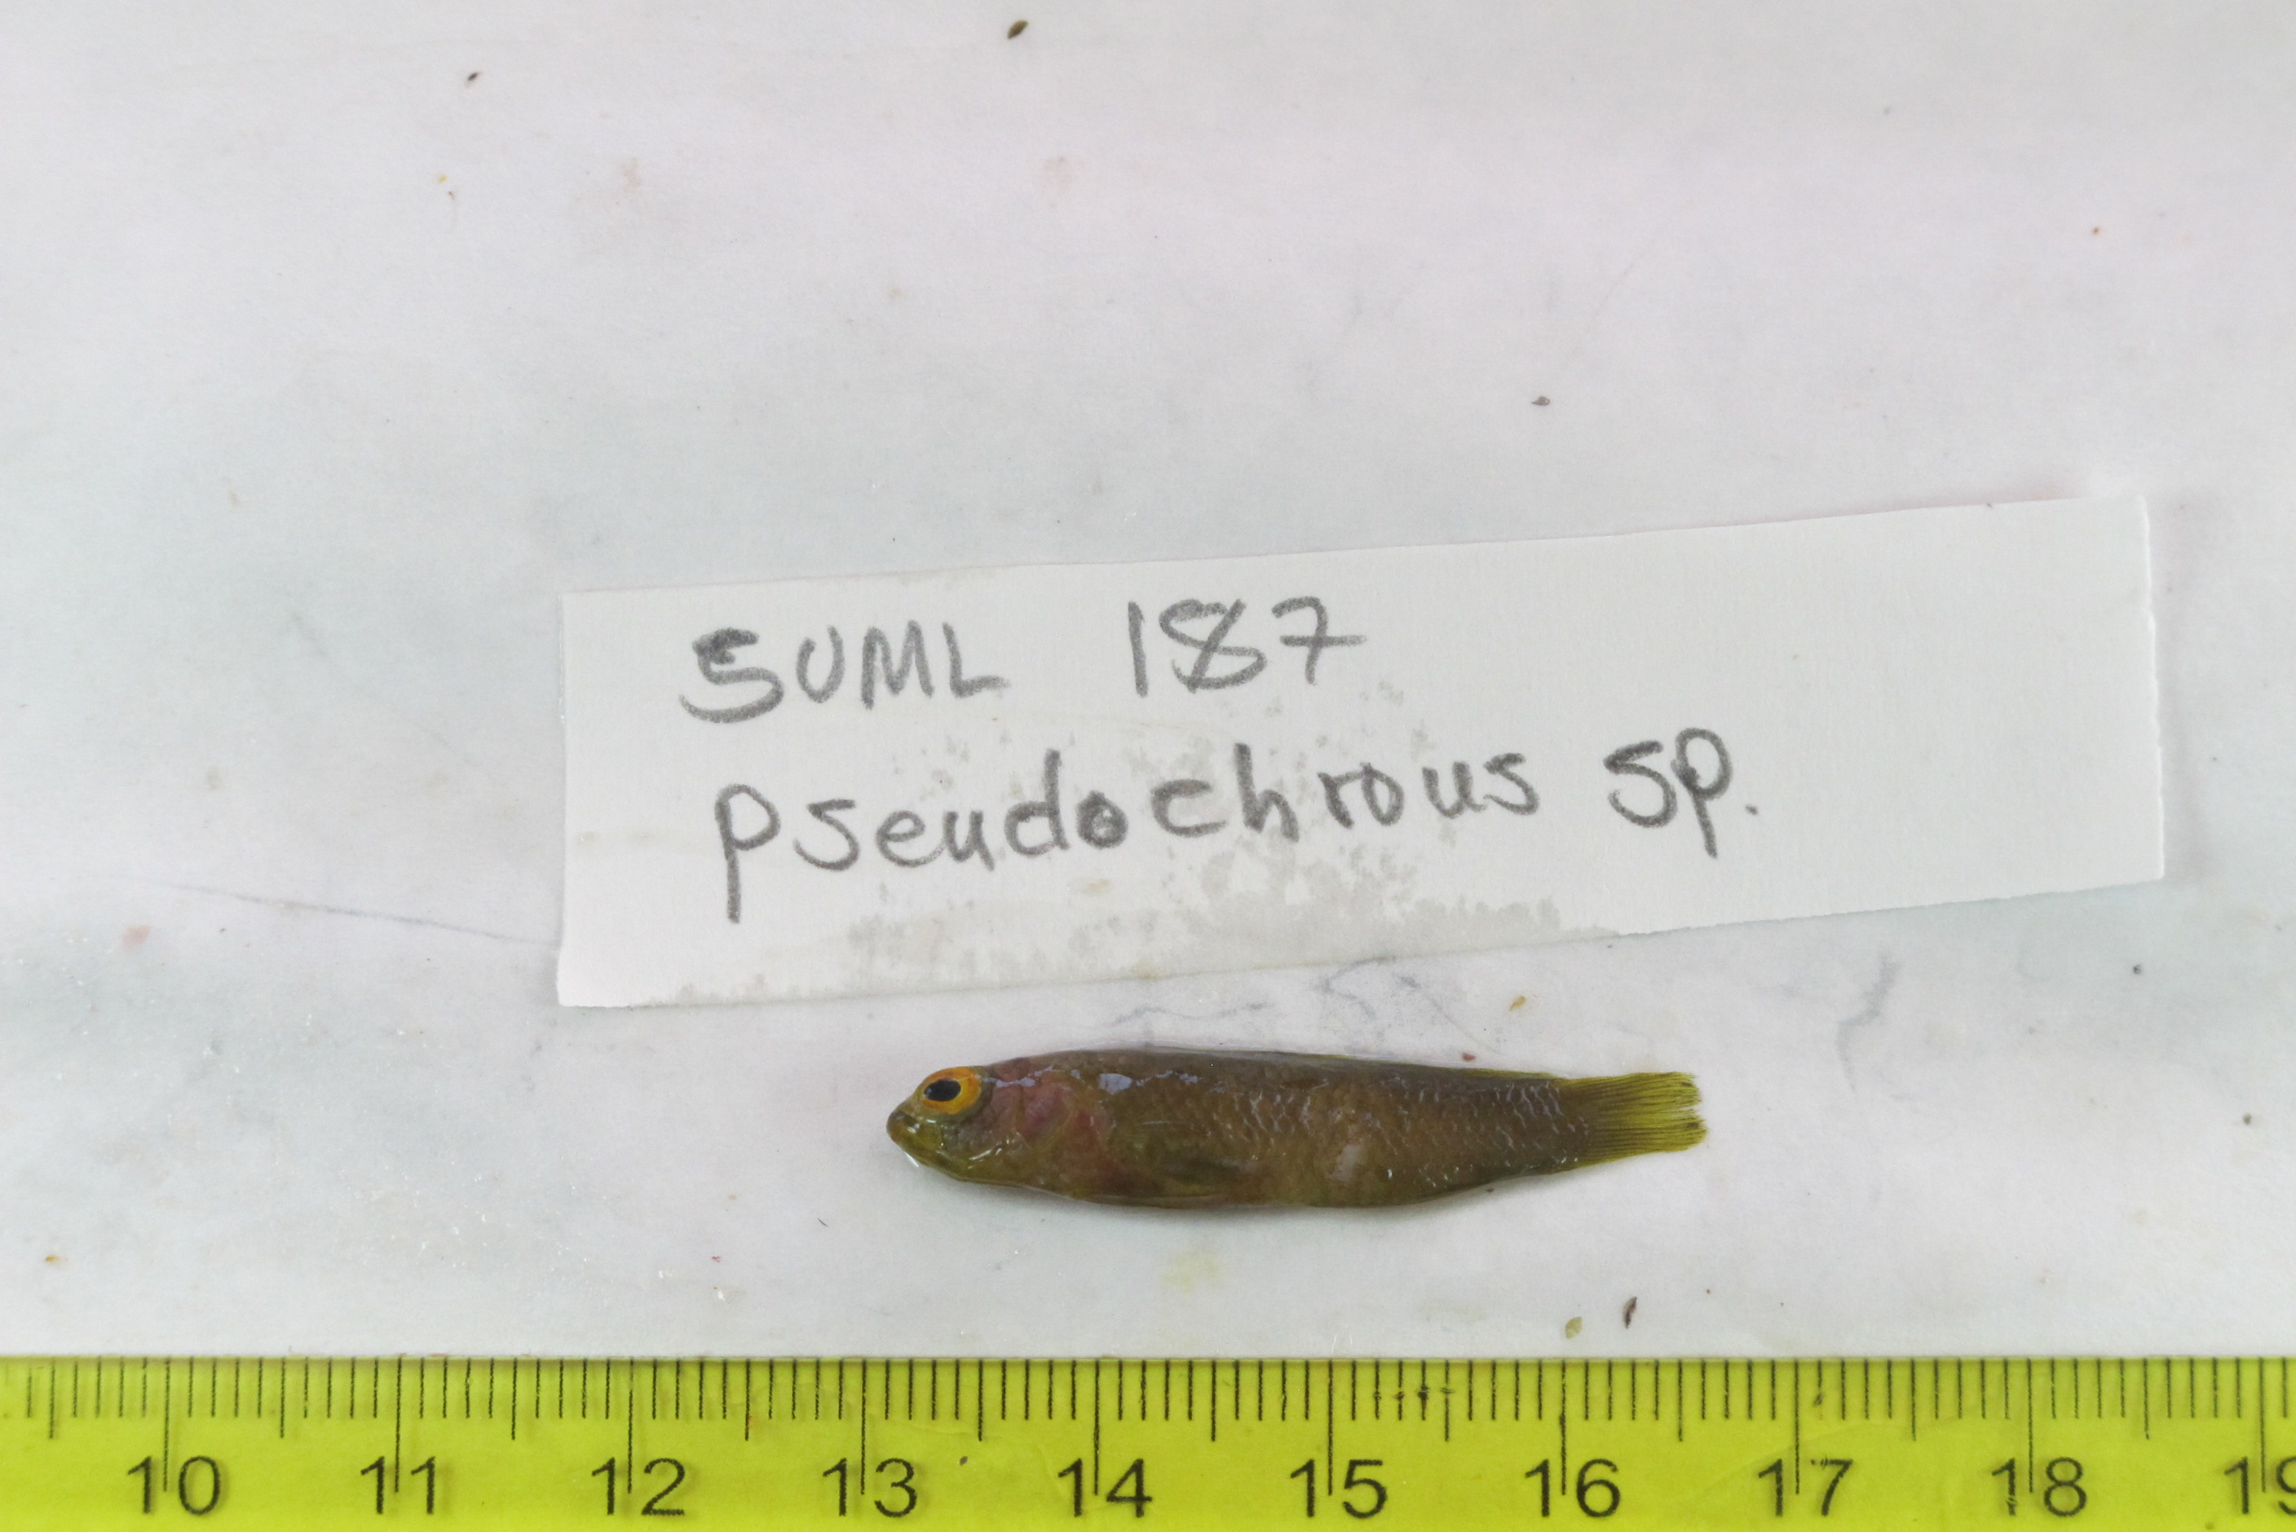
SU-19-03_066 (SUML-187) Original ID: Pseudochromis sp. Jeff’s ID:

Slide 6
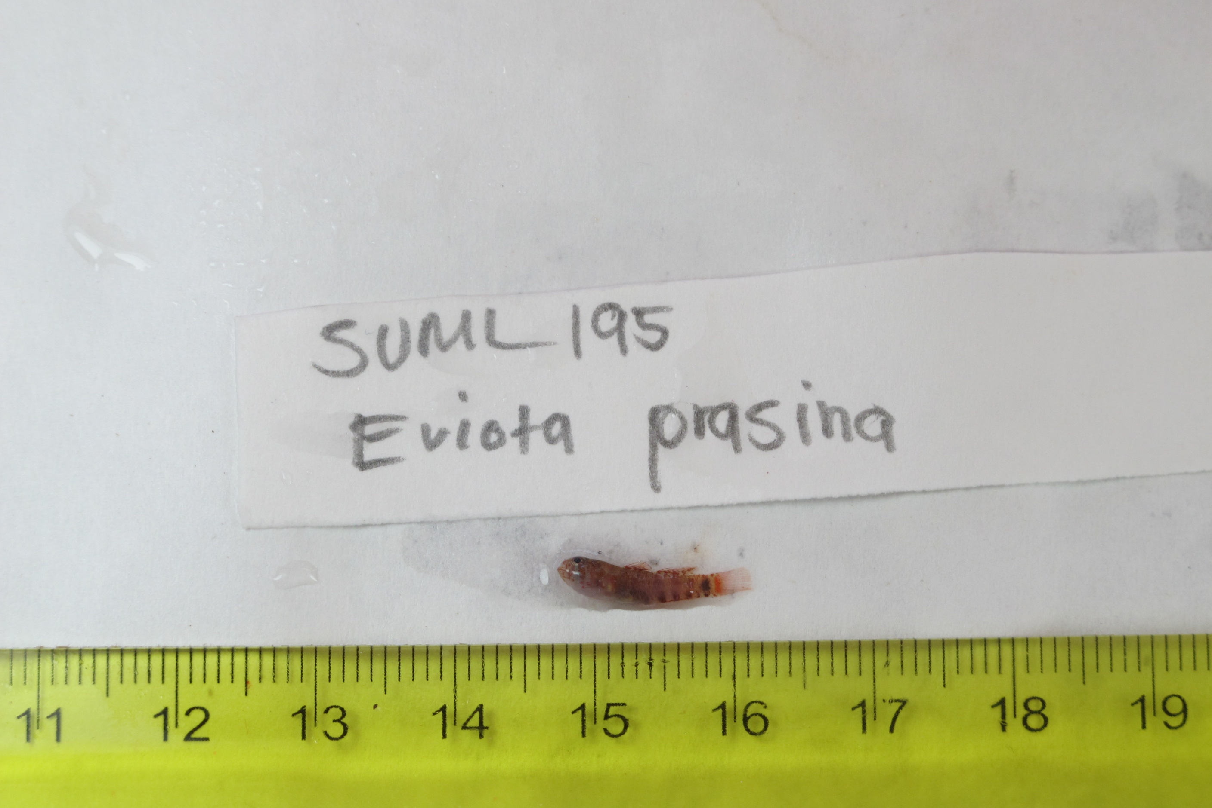
SU-19-03_074 (SUML-195) Original ID: Eviota prasina (?) Jeff’s ID:

Slide 7
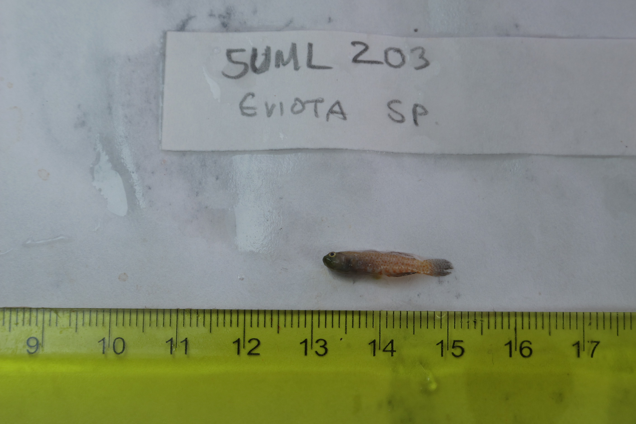
SU-19-03_082 (SUML-203) Original ID: Eviota sp. Jeff’s ID:

Slide 8
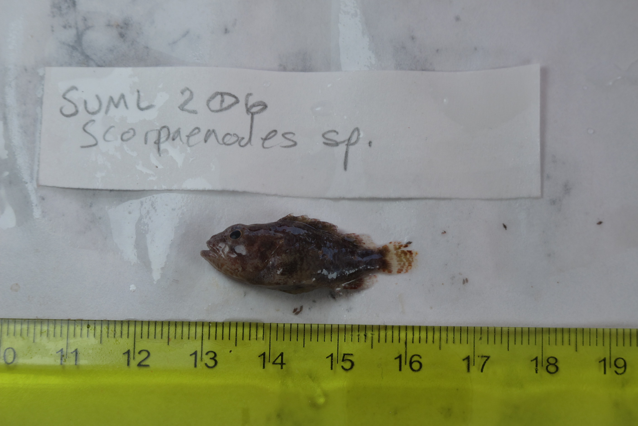
SU-19-03_085 (SUML-206) Original ID: Scorpaenodes sp. Jeff’s ID:

Slide 9
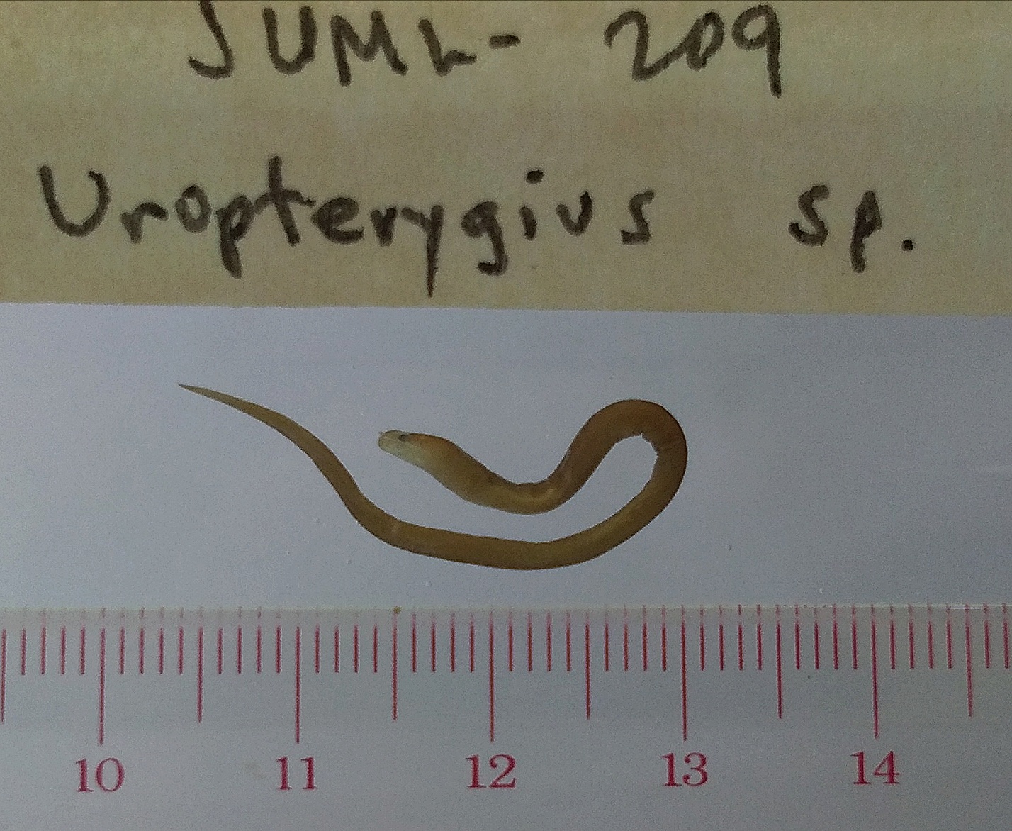
SU-19-03_088 (SUML-209) Original ID: Uropterygius sp. Jeff’s ID:

